Slide 1
Natural Disaster Data Analysis
Taylor Vought
Michael Munson
Tiffany Hernandez
Rachel Harless

Slide 2
Types of Disasters Examined:
Floods
Fires
Earthquakes
Severe Storms
Hurricanes

Slide 3
Hernandez: Overarching Tasks to Complete
Locate Data, and Save CSVs
Research population effect of natural disaster
(not successful)
Organize and clean top five natural disasters.
Make visualizations
My work Final Code Analysis Doc

Slide 4
1.
Which natural disasters are more common in the US?
-Tiffany Hernandez

Slide 5
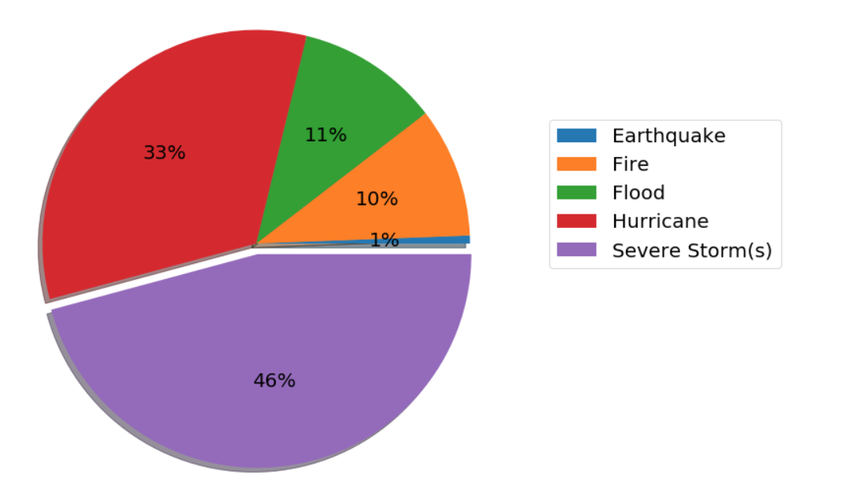
FEMA Data: Top 5 Natural Disasters from 1998 - 2020

Slide 6
Harless: Overarching Tasks to Complete
Locate Data, and Save CSVs
Clean Frequency and Cost FEMA csv files
Locate and organize key data values from CSV
Make visualizations
My work Final Code Analysis Doc

Slide 7
2.
Which states have a higher frequency of natural disasters?
-Rachel Harless

Slide 8
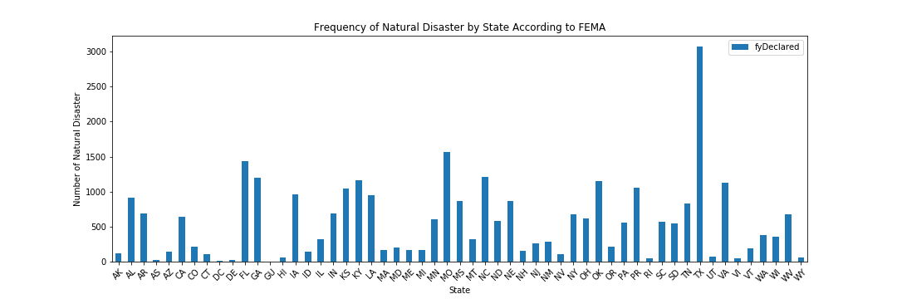
FEMA Data: Frequency of Natural Disasters from 1998 - 2020

Slide 9
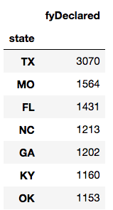
Top Seven

Slide 10
3.
Which state’s natural disasters cost the most money?
-Rachel Harless

Slide 11
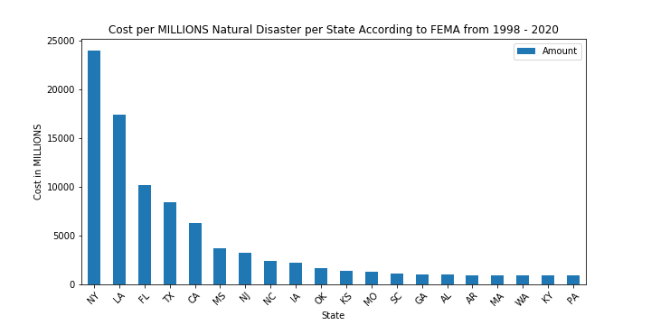
FEMA Data: Cost of Natural Disasters from 1998 - 2020

Slide 12
4.
States with the most natural disasters and their associated cost.
-Rachel Harless

Slide 13
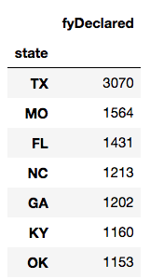
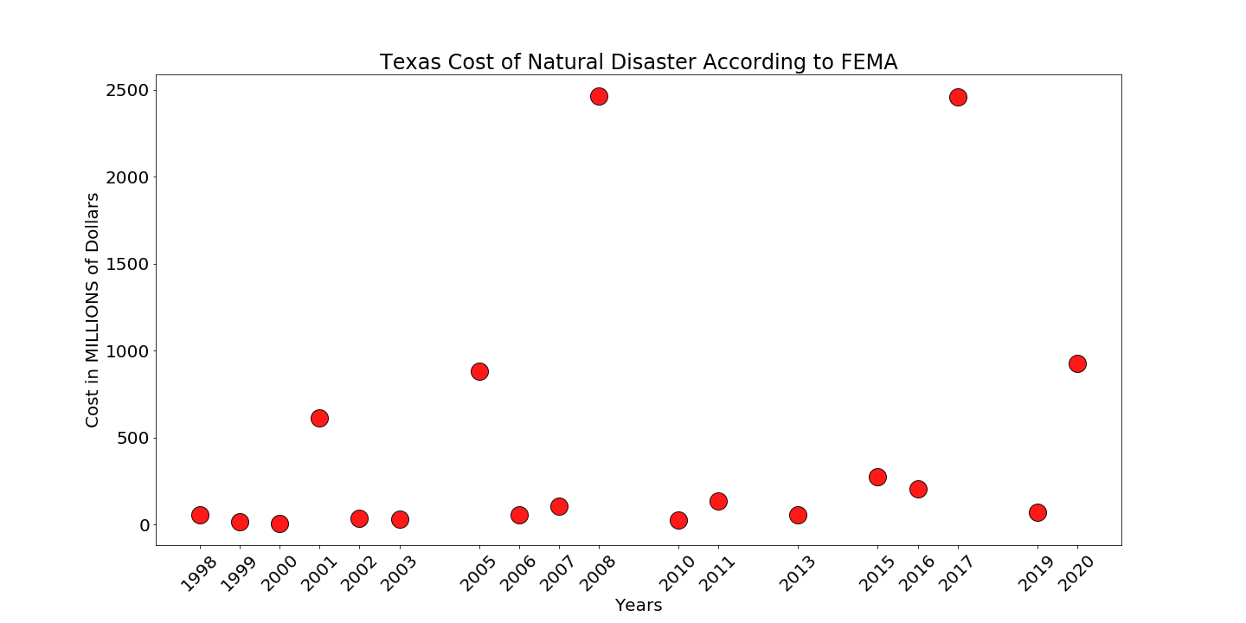
FEMA Data: 1998 -2020

Slide 14
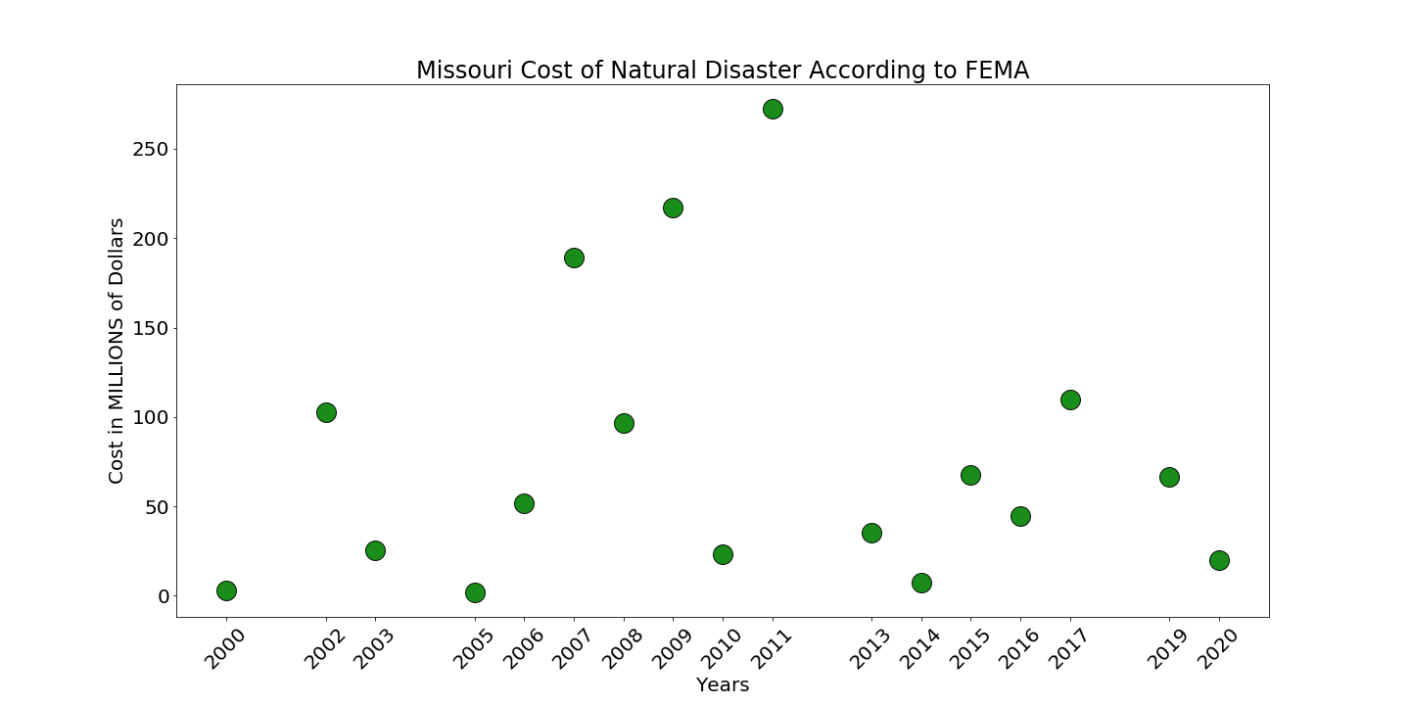
FEMA Data: 1998 -2020

Slide 15
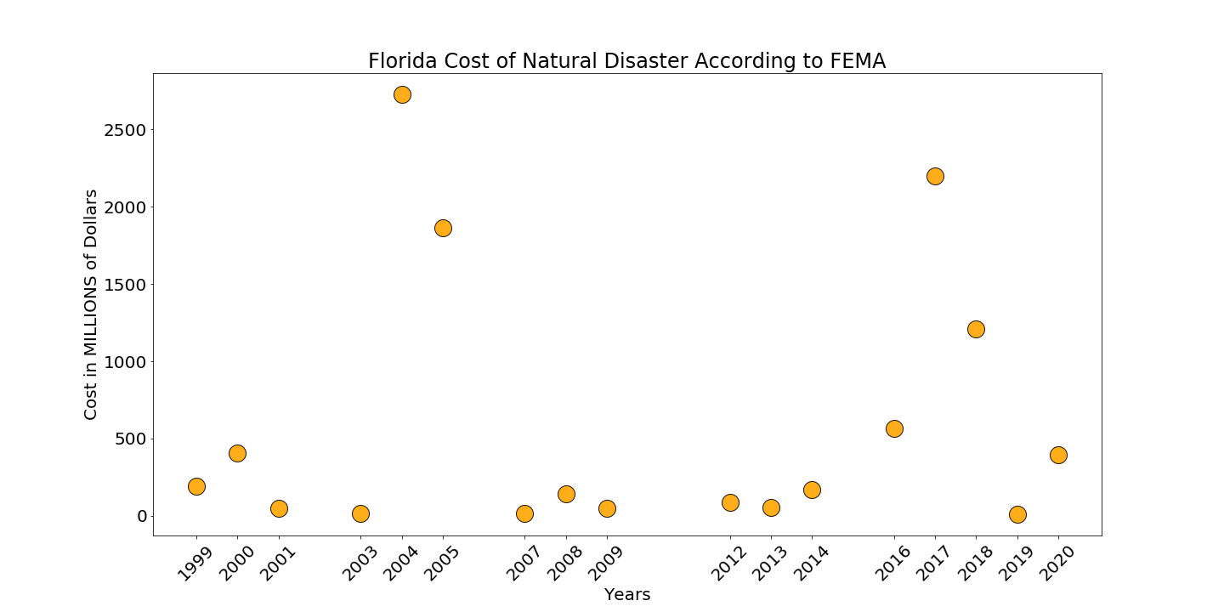
FEMA Data: 1998 -2020

Slide 16
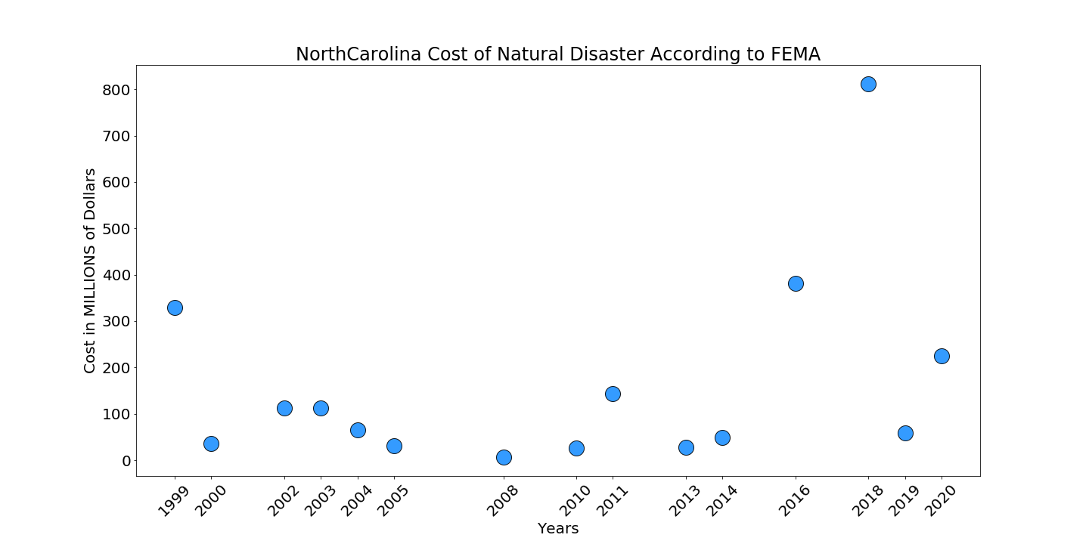
FEMA Data: 1998 -2020

Slide 17
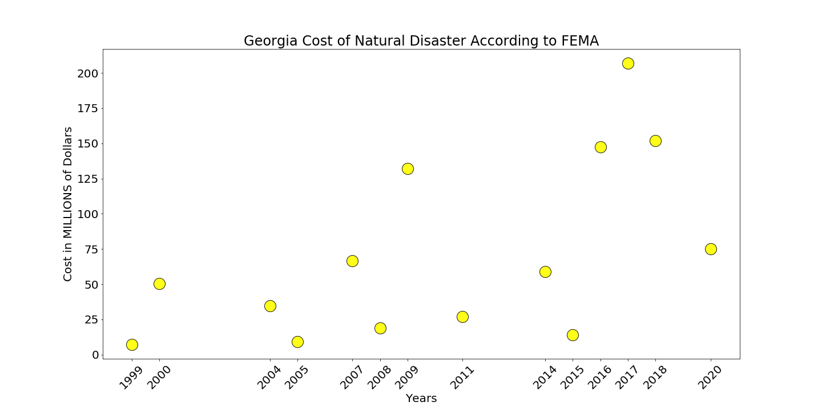
FEMA Data: 1998 -2020

Slide 18
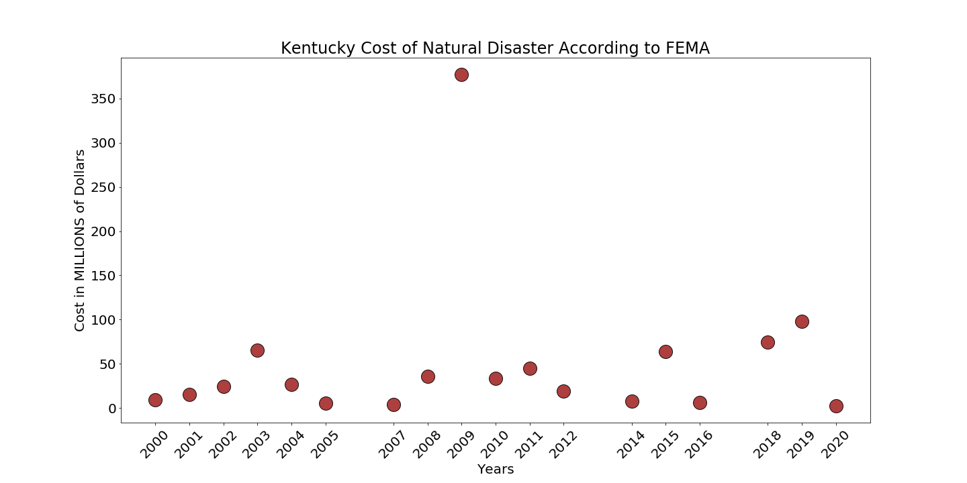
FEMA Data: 1998 -2020

Slide 19
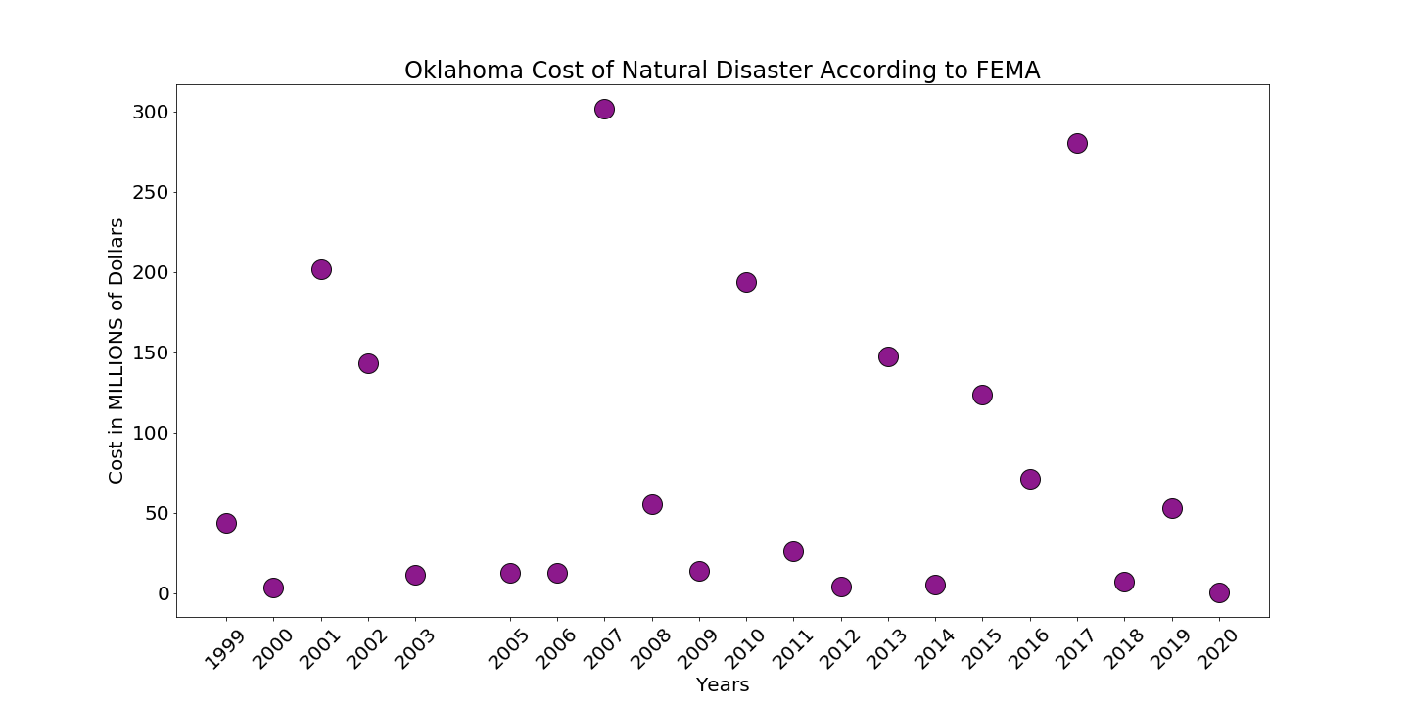
FEMA Data: 1998 -2020

Slide 20
5.
How are gas prices affected by natural disasters across the states?
-Taylor Vought

Slide 21
Overarching Tasks to Complete
Locate Data, Run API Calls, & Save CSVs
Group Fema/Disaster Data by Year & State
Clean Irrelevant Data & Deflate Gas Data
Locate Top States by Disaster Count
Run Scatter Plots and Linear Regression
My work Final Code Analysis Doc

Slide 22
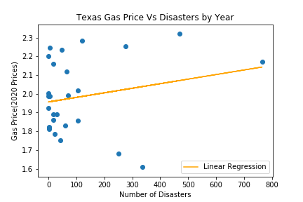
Texas-2826
Disasters
(1984-2010)

Slide 23
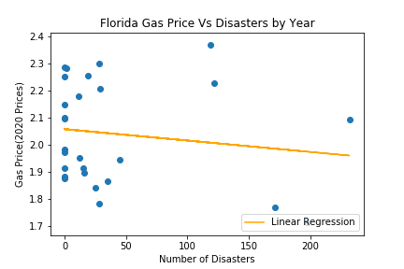
Florida-1105
Disasters
(1984-2010)

Slide 24
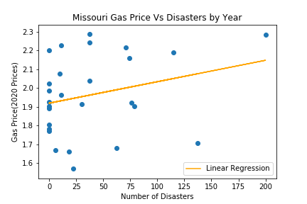
Missouri-1033
Disasters
(1984-2010)

Slide 25
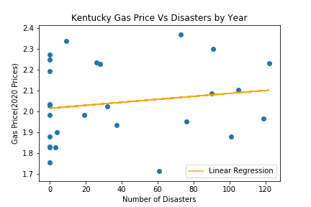
Kentucky-996
Disasters
(1984-2010)

Slide 26
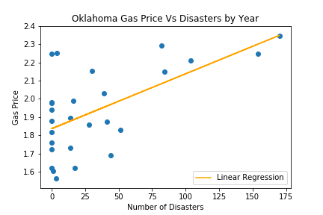
Oklahoma-896
Disasters
(1984-2010)

Slide 27
Munson Overarching Tasks to Complete
Locate Data, Run API Calls, & Save CSVs
Group Data by Year & State
Clean and Remove Unnecessary Data
Compare Disasters, Temp, and Precip
Create Visualizations
My work Final Code Analysis Doc

Slide 28
6.
How do natural disasters affect weather?
-Michael Munson

Slide 29
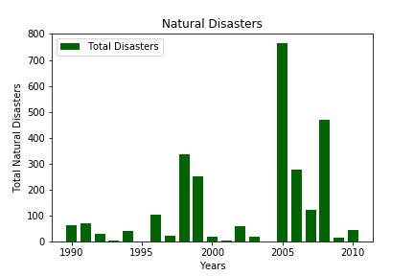
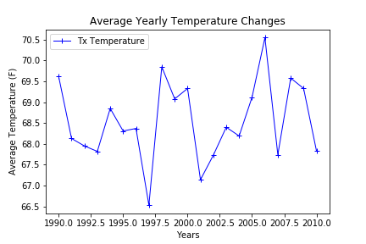
Texas Temperatures
(1990-2010)

Slide 30
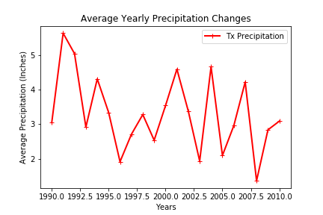
Texas Precipitation
(1990-2010)

Slide 31
Oklahoma Temperatures
(1990-2010)

Slide 32
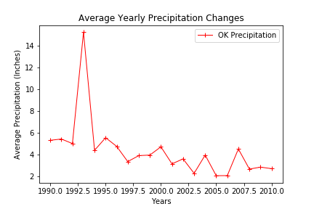
Oklahoma Precipitation
(1990-2010)

Slide 33
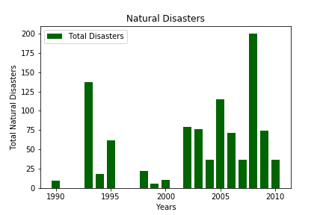
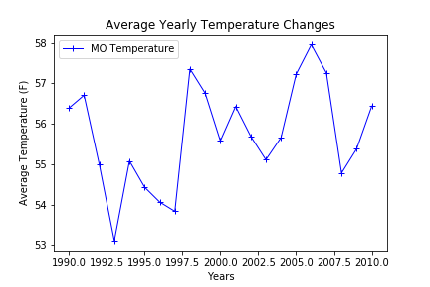
Missouri Temperatures
(1990-2010)

Slide 34
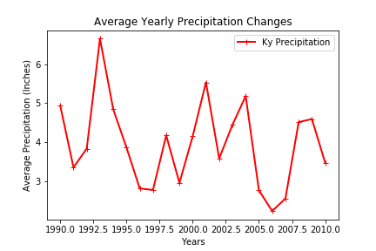
Missouri Precipitation
(1990-2010)

Slide 35
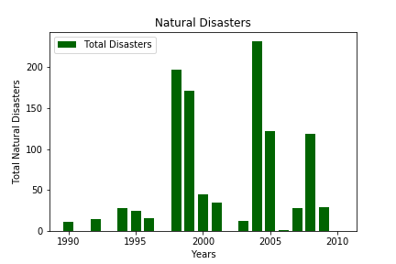
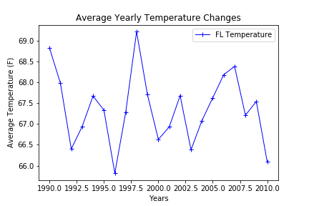
Florida Temperatures
(1990-2010)

Slide 36
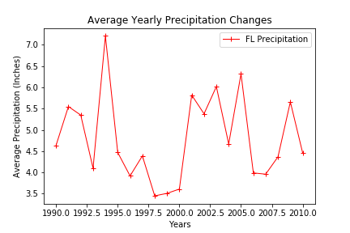
Florida Precipitation
(1990-2010)

Slide 37
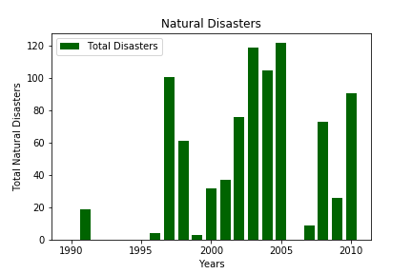
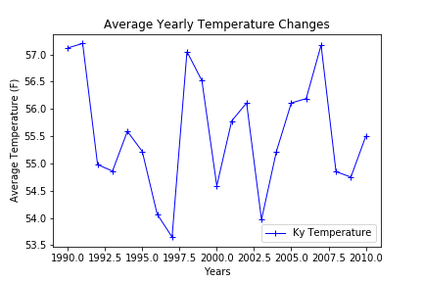
Kentucky Temperatures
(1990-2010)

Slide 38
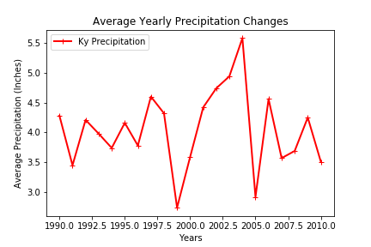
Kentucky Precipitation
(1990-2010)

